Slide 1
Definition of Half-Range Fourier series
An odd extension of f(x) of the period 2L leads to a Fourier sine series:
where and
An even extension of f(x) of period 2L leads to a Fourier cosine series:
where and

Slide 2
Example of Half-Range Fourier series
Example: Find the Half range Fourier sine and cosine series for
Solution:
Step 1: Half range Fourier sine series (Odd periodic extension)

Slide 3
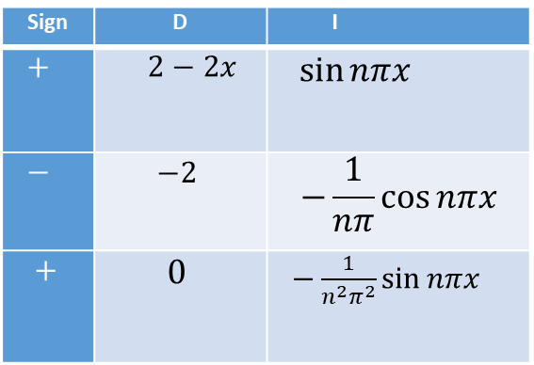
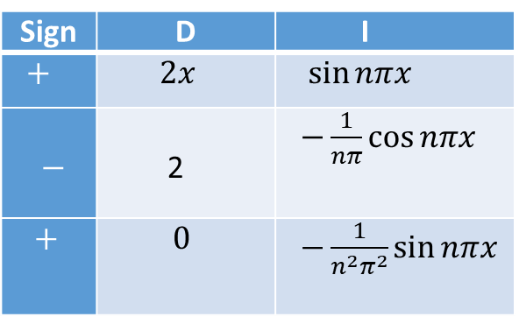
Example of Half-Range Fourier series
Sign | D | I
$+$ | $2−2x$ | $\sin{nπx}$
$−$ | $$−2$$ | $$−\frac{1}{nπ}\cos{nπx}$$
$+$ | $$0$$ | $−\frac{1}{n^{2}π^{2}}\sin{nπx}$
Step 2:
Here, L=1.
For Half Rang Fourier Sine series : a_{n} = 0 for all n.
Sign | D | I
$+$ | $2x$ | $\sin{nπx}$
$−$ | 2 | $−\frac{1}{nπ}\cos{nπx}$
$+$ | $0$ | $−\frac{1}{n^{2}π^{2}}\sin{nπx}$

Slide 4
Example of Half-Range Fourier series(continued)
Step 3:
Therefore the half range Fourier sine series for f (x) on [0, 1] is
Now, for Half range Fourier cosine series
Step 1: Half range Fourier cosine series (Even periodic extension)

Slide 5
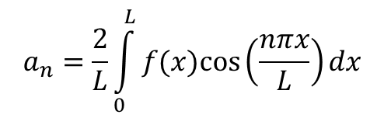
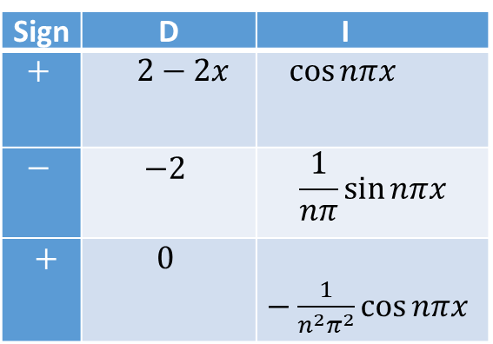

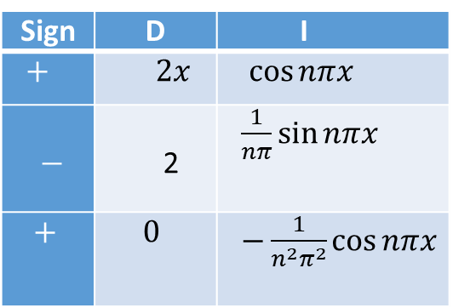
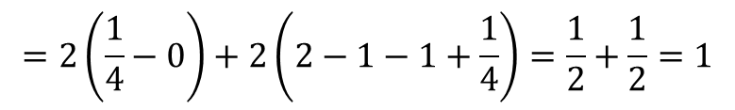
Example of Half-Range Fourier series
Sign | D | I
$+$ | $2x$ | $\cos{nπx}$
$−$ | 2 | $\frac{1}{nπ}\sin{nπx}$
$+$ | $0$ | $−\frac{1}{n^{2}π^{2}}\cos{nπx}$
Step 2:
Here, L=1
For Half range Fourier Cosine series : b_{n} = 0 for all n.
$$=2\left(\frac{1}{4}−0\right)+2\left(2−1−1+\frac{1}{4}\right)=\frac{1}{2}+\frac{1}{2}=1$$
Sign | D | I
$+$ | $2−2x$ | $\cos{nπx}$
$−$ | $$−2$$ | $$\frac{1}{nπ}\sin{nπx}$$
$+$ | $$0$$ | $−\frac{1}{n^{2}π^{2}}\cos{nπx}$
$$a_{n}=\frac{2}{L}\int_{0}^{L}{f(x)cos\left(\frac{nπx}{L}\right)dx}$$
$$=\frac{2}{L}\int_{0}^{L}{f(x)cos\left(\frac{nπx}{L}\right)}dx$$

Slide 6
Example of Half-Range Fourier series(continued)
Step 3:
Therefore the half range Fourier cosine series for f (x) on [0, 1] is

Slide 7
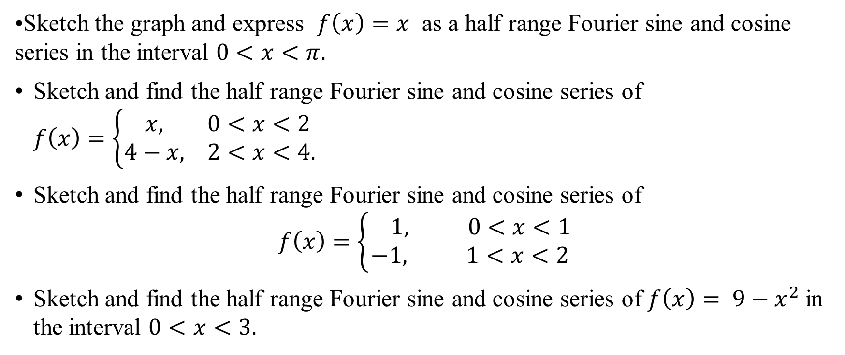
Sample Exercise
Sketch the graph and express $f\left(x\right)=x$ as a half range Fourier sine and cosine series in the interval $0<x<π.$
Sketch and find the half range Fourier sine and cosine series of $f\left(x\right)=\left\{\begin{aligned} x, 0<x<2 \\ 4−x, 2<x<4.\end{aligned}\right.$
Sketch and find the half range Fourier sine and cosine series of
$$f\left(x\right)=\left\{\begin{aligned} 1, 0<x<1 \\ −1, 1<x<2\end{aligned}\right.$$
Sketch and find the half range Fourier sine and cosine series of $f\left(x\right)= 9−x^{2}$ in the interval $0<x<3.$

Slide 8
Fourier Integral
Fourier integral is a formula for the decomposition of a non-periodic function into harmonic components whose frequencies range over a continuous set of values.
The Fourier integral of non-periodic function f(x) but piecewise continuous in any infinite interval as follows:
where and

Slide 9

Fourier cosine integral:
where and
If the function f(x) is even and writing $v=x$
(even) and (odd)
Hence, the Fourier cosine integral of f(x) is

Slide 10

Fourier sine integral:
where and
If the function f(x) is odd then and writing $v=x$
(odd) and (even)
Hence, the Fourier sine integral of f(x) is

Slide 11
Fourier Integral
Useful formula:

Slide 12

Example of Fourier Integral (continued)
Example:
Find the Fourier integral of where and hence prove that
Solution:
$=\frac{2}{π}[0−\frac{1\left(0−w\right)}{w^{2}+4}]$

Slide 13
Hence the Fourier integral of f(x) is,
Now,
(proved)

Slide 14
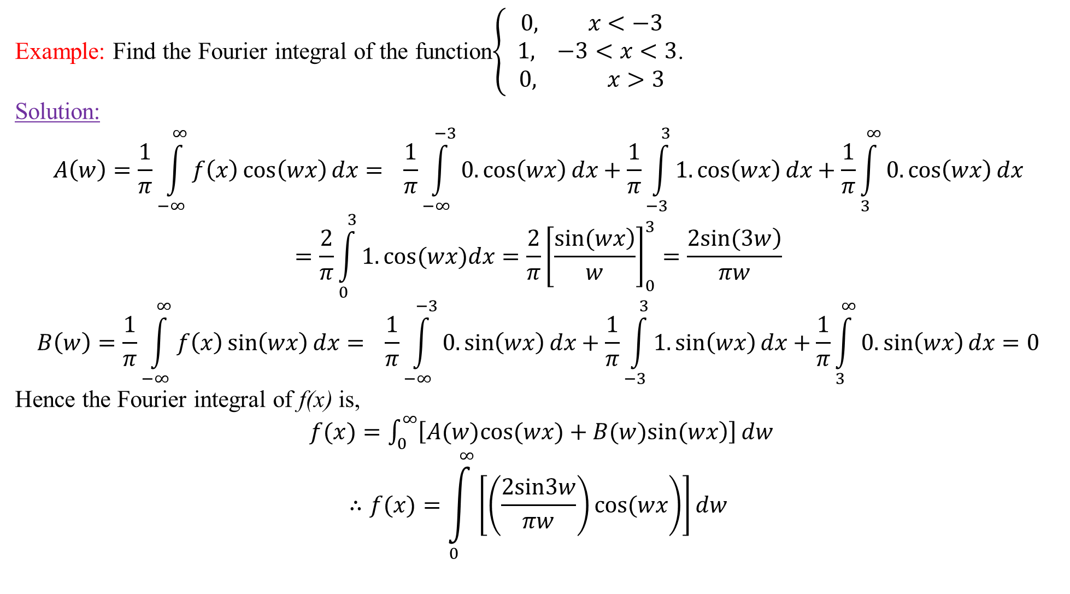
Example: Find the Fourier integral of the function$\left\{\begin{aligned}0, x<−3 \\ 1, −3<x<3 \\ 0, x>3\end{aligned}\right.$.
Solution:
$$A\left(w\right)=\frac{1}{π}\int_{−∞}^{∞}{f\left(x\right)\cos\left(wx\right)dx}= \frac{1}{π}\int_{−∞}^{−3}{0.\cos\left(wx\right)dx}+\frac{1}{π}\int_{−3}^{3}{1.\cos\left(wx\right)dx}+\frac{1}{π}\int_{3}^{∞}{0.\cos\left(wx\right)dx}$$
$$=\frac{2}{π}\int_{0}^{3}{1.cos(wx)dx}=\frac{2}{π}{\left[\frac{\left.sin(wx\right)}{w}\right]}_{0}^{3}=\frac{\left.2sin(3w\right)}{πw}$$
$$B\left(w\right)=\frac{1}{π}\int_{−∞}^{∞}{f\left(x\right)\sin\left(wx\right)dx}= \frac{1}{π}\int_{−∞}^{−3}{0.\sin\left(wx\right)dx}+\frac{1}{π}\int_{−3}^{3}{1.\sin\left(wx\right)dx}+\frac{1}{π}\int_{3}^{∞}{0.\sin\left(wx\right)dx}=0$$
Hence the Fourier integral of f(x) is,
$f(x)=\int_{0}^{∞}{\left[\left.A(w)cos(wx)+B(w)sin(wx\right)\right]}dw$
$$∴f(x)=\int_{0}^{∞}{\left[\left.\left(\frac{2sin3w}{πw}\right)cos(wx\right)\right]}dw$$

